Slide 1
Lecture:-2
Overview of Graphics Systems

Slide 2
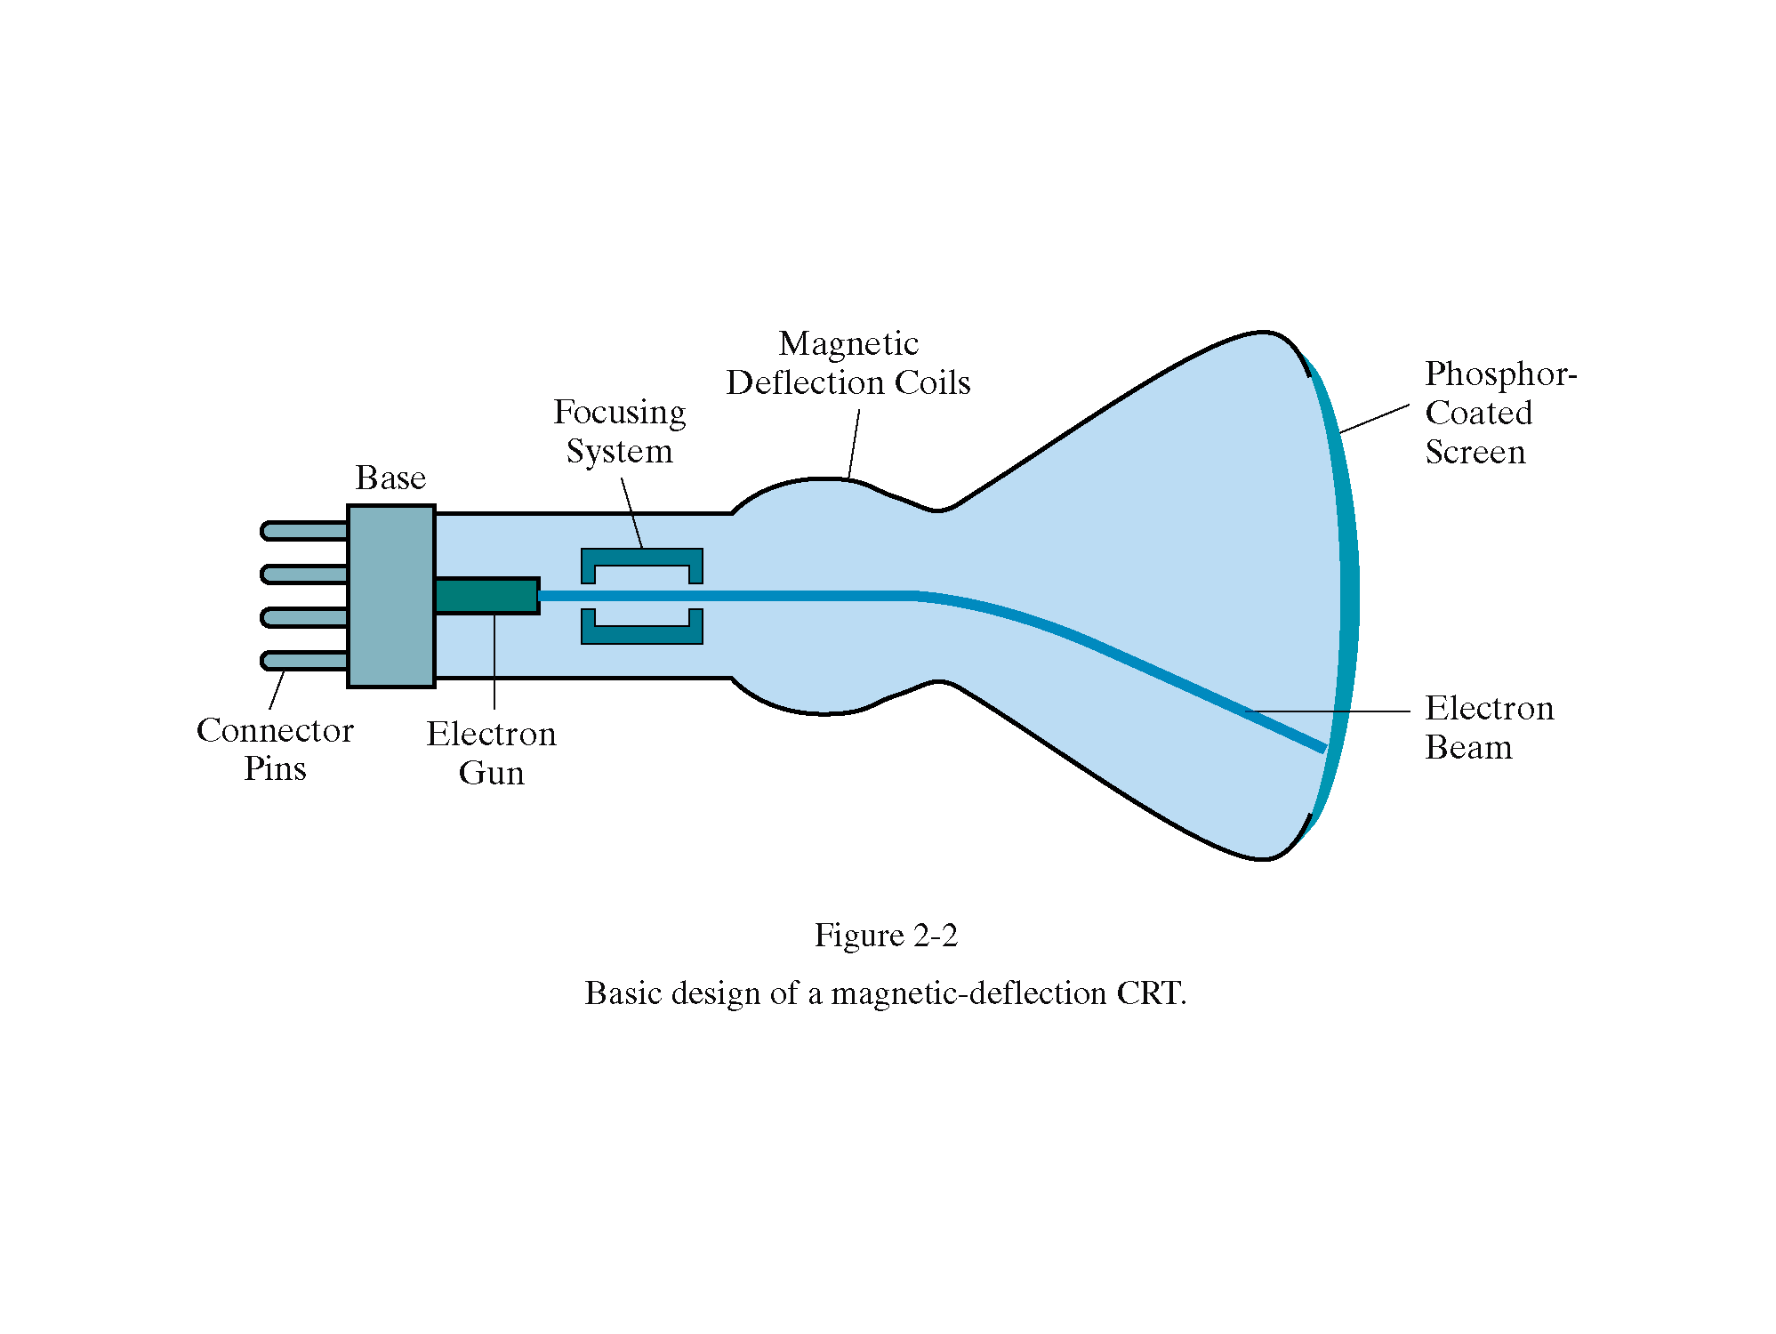
Cathode-Ray Tube
Computer Graphics

Slide 3
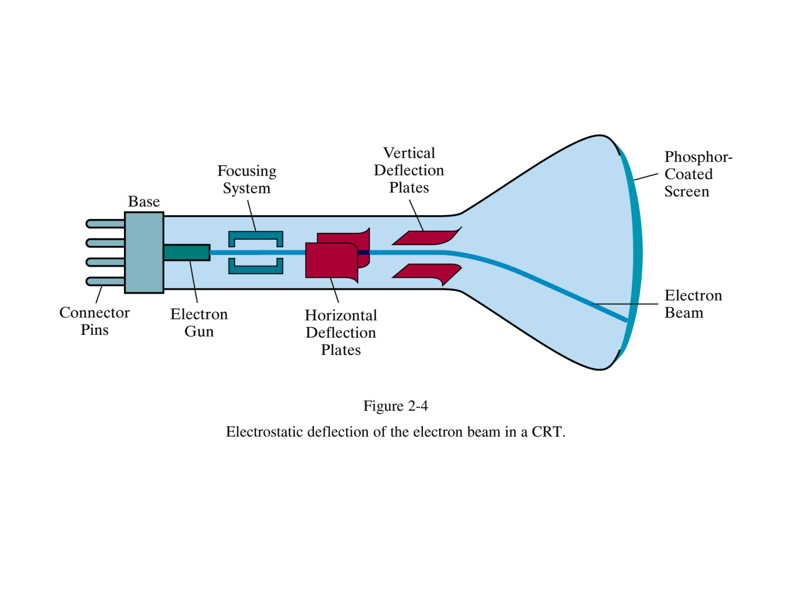
Cathode-Ray Tube
Computer Graphics

Slide 4
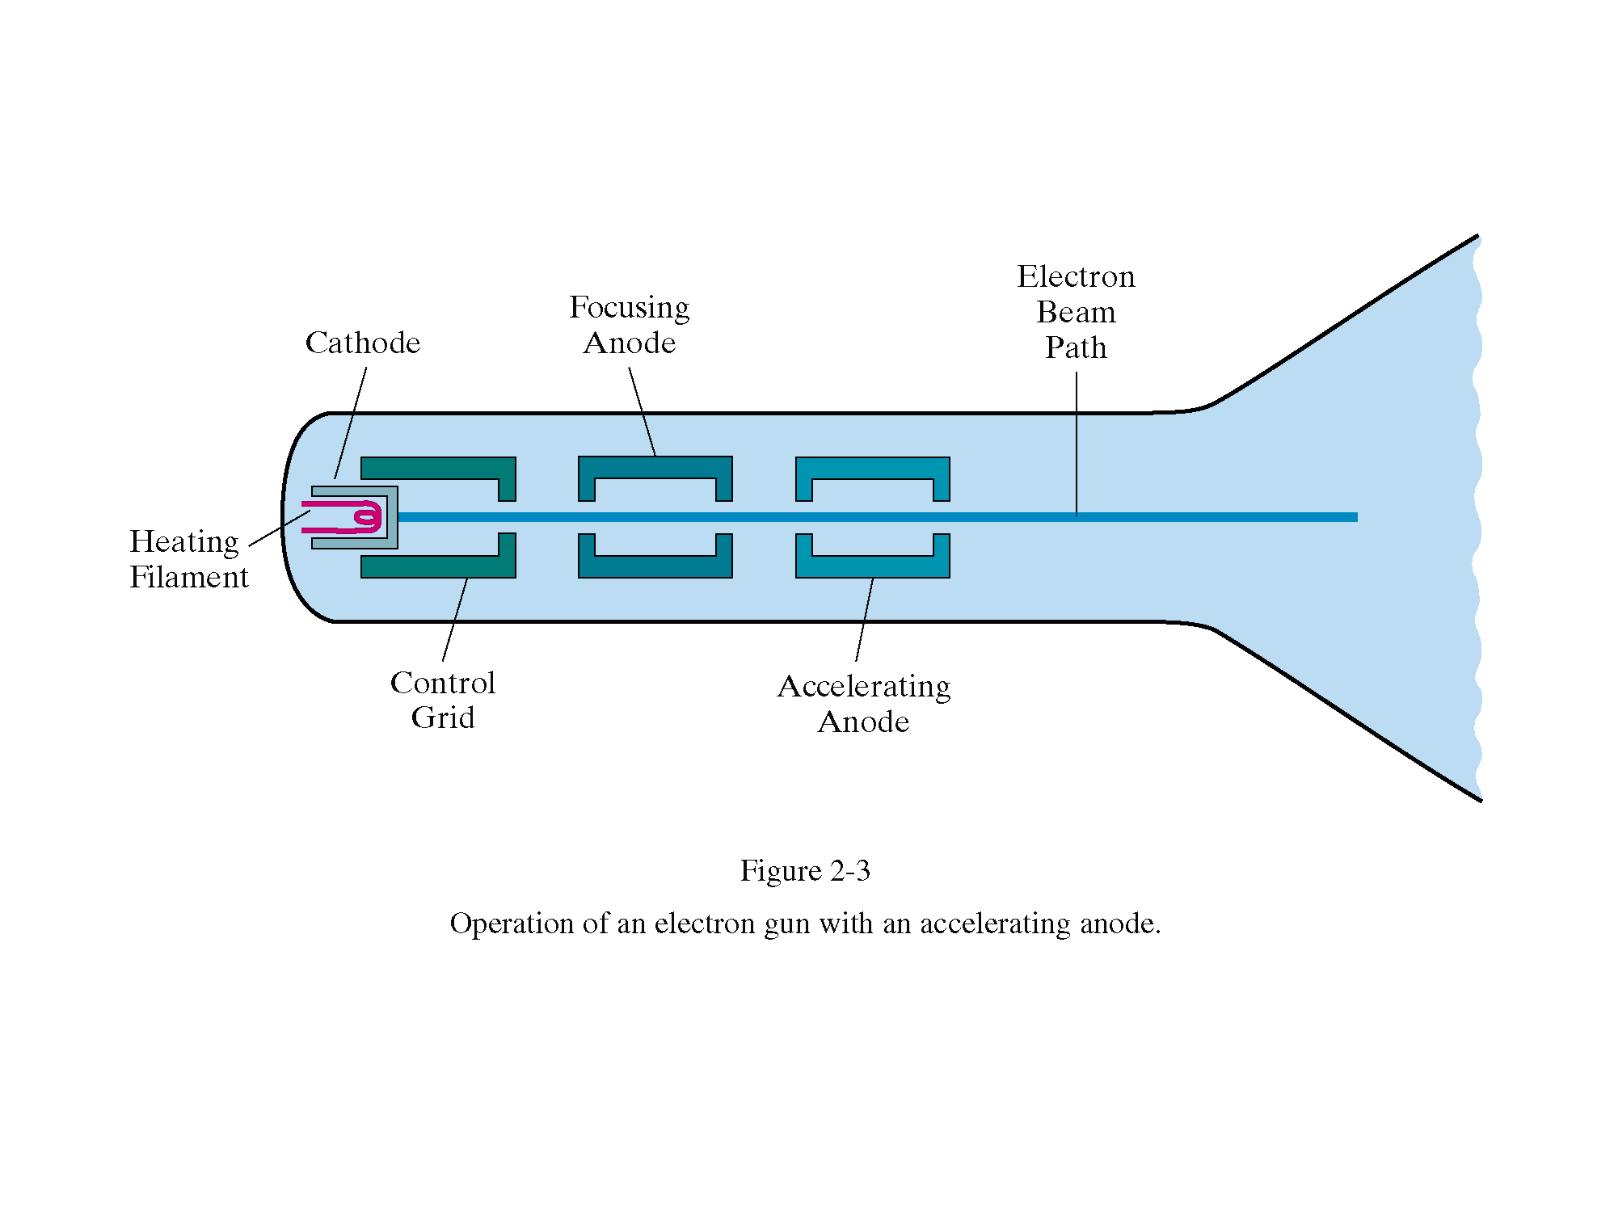
Cathode-Ray Tube
Computer Graphics

Slide 5
CRT
A beam of electrons (cathode rays), emitted by an electron gun, passes through focusing and deflection systems that direct the beam toward specified positions on the phosphor coated screen.
The phosphor then emits a small spot of light at each position contacted by the electron beam. Because the light emitted by the phosphor fades very rapidly, some method is needed for maintaining the screen picture.
One way to keep the phosphor glowing is to redraw the picture repeatedly by quickly directing the electron beam back over the same points. This type of display is called a refresh CRT
cgvr.korea.ac.kr

Slide 6
Cathode-Ray Tubes
1. Working of CRT
  Beam of electrons directed from cathode (-)to phosphor-coated (fluorescent) screen (anode (+))
  Directed by magnetic focusing and deflection coils (anodes) in vacuum filled tube
  Phosphor emits photon of light, when hit by an electron, of varied persistence (long 15-20 ms for texts / short < 1ms for animation)
  Refresh rate (50-60 Hz / 72-76 Hz) to avoid flicker / trail
  Phosphors are organic compounds characterized by their persistence and their color (blue, red, green).
Computer Graphics

Slide 7
Cathode-Ray Tubes
  Horizontal deflection and vertical deflection direct the electron beam to any point on the screen
  Intensity knob: regulates the flow of electrons by controlling the voltage at the control grid (high voltage reduces the electron density and thus brightness)
  Accelerating voltage from positive coating inside screen (anode screen) or an accelerating anode
2. Image maintenance
  Charge distribution to store picture information OR
  Refresh CRT: refreshes the display constantly to maintain phosphor glow.
Computer Graphics

Slide 8
Cathode-Ray Tubes
3. Focusing
  Focusing forces the electron beam to converge to a point on the monitor screen
  Can be electrostatic (lens) or magnetic (field)
4. Deflection
  Deflection directs the electron beam horizontally and/or vertically to any point on the screen
  Can be controlled by electric (deflection plates, slide 9) or magnetic fields (deflection coils, slide 5)
  Magnetic coils: two pairs (top/bottom, left/right) of tube neck
  Electric plates: two pairs (horizontal, vertical)
Computer Graphics

Slide 9
Cathode-Ray Tubes
Characteristics of Cathode-Ray Tube (CRT)
  Intensity is proportional to the number of electrons repelled in beam per second (brightness)
  Resolution is the maximum number of points that can be displayed without overlap; is expressed as number of horizontal points by number of vertical points; points are called pixels (picture elements); example: resolution 1024 x 768 pixels. Typical resolution is 1280 x 1024 pixels.
    High-definition systems: high resolution systems.
Computer Graphics

Slide 10
Cathode-Ray Tubes
  Persistence is defined as the time taken by the emitted light to decay one tenth of its original intensity.
    Max persistence 1 Sec, Min Persistence 10-60 μ sec
    Higher persistence ∼ Low refresh rate ∼ complex images
    Lower persistence ∼ High refresh rate ∼ Animations
  Refresh Rate (Hz) number of times screen drawn or refreshed per second.
    Usually 60 Hz (Why)
    Depends upon persistence
  Pixel Picture Element
    Mapping of phosphorus element to pixel
    Bit for monochrome
    Byte for 256 color levels
    3 Bytes to produce more than 16.7 million colors
Computer Graphics

Slide 11
Raster-scan Displays
1. Introduction
  Raster-scan display is the most common type of monitor using a CRT.
  A raster is a matrix of pixels covering the screen area and is composed of raster lines.
  The electron beam scans the screen from top to bottom one row at a time. Each row is called a scan line.
  The electron beam is turned on and off to produce a collection of dots painted one row at a time. These will form the image.
Computer Graphics

Slide 12
Raster Scan Displays
The most common type of graphics monitor employing a CRT is the raster-scan display, based on television technology. In a raster-scan system, the electron beam is swept across the screen, one row at a time from top to bottom.
As the electron beam moves across each row, the beam intensity is turned on and off to create a pattern of illuminated spots.
Picture definition is stored in a memory area called the refresh buffer or frame buffer.
cgvr.korea.ac.kr

Slide 13
Raster Scan Displays(contd..)
This memory area holds the set of intensity values for all the screen points.
Stored intensity values are then retrieved
from the refresh buffer and "painted" on the screen one row (scan line) at a time
Each screen point is referred to as a pixel or pel (shortened form of picture element).
cgvr.korea.ac.kr

Slide 14
Raster Scan Displays(contd..)
On a black-and-white system with one bit per pixeI, the frame buffer is commonly called a bitmap.
For systems with multiple bits per pixel, the frame buffer is referred to as a pixmap.
cgvr.korea.ac.kr

Slide 15
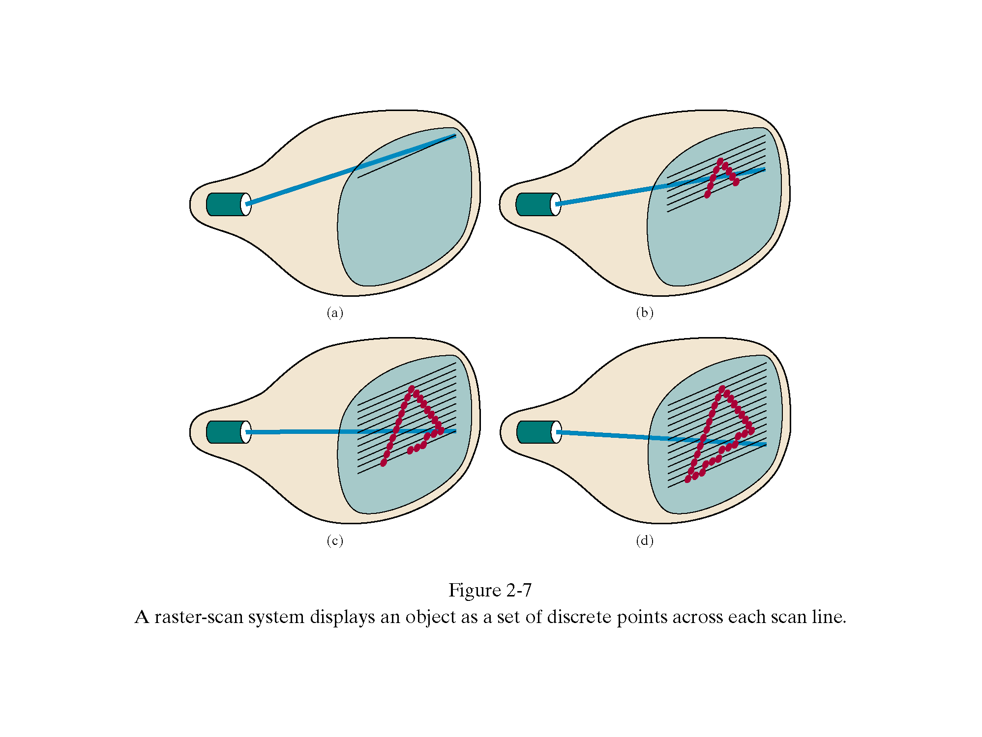
Raster-scan Displays
Computer Graphics

Slide 16
Raster-scan Displays
2. Refresh Procedure
  Retracing
    Horizontal retrace – beam returns to left of screen
    Vertical retrace – bean returns to top left corner of screen
  Interlacing
    display first even-numbered lines, then odd-numbered lines
    permits to see the image in half the time
    useful for slow refresh rates (30 Hz shows as 60 Hz).
Computer Graphics

Slide 17
Raster-scan Displays
  Over scanning
    Scan lines extended beyond visibility edge as there is limit on speed of sweep generator
    Avoid cracking at borders and distortion
    Top and Bottom Vertical Over scanning
    Left and Right Horizontal Over scanning
  Refresh rate
    24 is a minimum to avoid flicker, corresponding to 24 Hz (1 Hz = 1 refresh per second)
    Current raster-scan displays have a refresh rate of at least 60 frames (60 Hz) per second, up to 120 (120 Hz).
Computer Graphics

Slide 18
Raster Scan Displays(contd..)
At the end of each scan line, the electron beam returns to the left side of the screen to begin displaying the next scan line. The return to the left of the screen, after refreshing each scan line electron beam is called the horizontal retrace of the beam
.
And at the end of each frame the electron beam returns (vertical retrace) to the top left corner of the screen to begin the next frame.
cgvr.korea.ac.kr

Slide 19
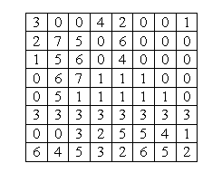
Raster-scan Displays
3.1 Frame Buffer
  Also called Refresh Buffer, contains picture definition
  The image is stored in a frame buffer containing the total screen area and where each memory location corresponds to a pixel.
  Consider it as 2-D memory array
  E.g. Frame buffer
    size 8x8
    Color depth 8 (values 0-7)
  Uses large memory:
    640x480 → 307200 bits → 38 kB
Computer Graphics

Slide 20
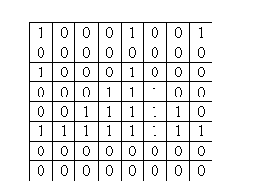
Raster-scan Displays
  Bitmap In a monochrome system, each bit is 1 or 0 for the corresponding pixel to be on or off making frame a bitmap.
  The display processor scans the frame buffer to turn electron beam on/off depending if the bit is 1 or 0.
  Example Bitmap
Computer Graphics

Slide 21
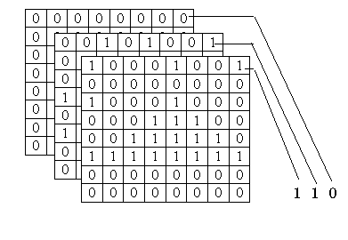
Raster-scan Displays
  Pixmap for color monitors, the frame buffer also contains the color of each pixel (color buffer) as well as other characteristics of the image (gray scale, …).
  Depth of the buffer area is the number of bits per pixel (bit planes), up to 24. 8 bits/pixel → 0..255
  Examples: television panels, printers, PC monitors
  8 level Pixmap
Computer Graphics

Slide 22
Random-scan Displays
1. Introduction
  Random scan systems are also called
    Vector Displays
    stroke-writing, or
    calligraphic displays.
  The electron beam directly draws the picture in any specified order.
  A pen plotter is an example of such a system.
Computer Graphics

Slide 23
Random-scan Displays
  Picture is stored in a display list, refresh display file, vector file, or display program as a set of line drawing commands.
  Refresh rate depends upon the size of the file.
  Refreshes by scanning the list 30 to 60 times per second.
  More suited for line-drawing applications such as architecture and manufacturing
Computer Graphics

Slide 24
Random Scan Display
When operated as a random-scan display unit, a CRT has the electron beam directed only to the parts of the screen where a picture is to be drawn.
Random scan monitors draw a picture one line at a time
for this reason are also referred to as vector displays (or stroke-writing or calligraphic displays).
cgvr.korea.ac.kr

Slide 25
Random Scan Display(contd..)
Refresh rate on a random-scan system depends on the number of lines to be displayed.
Picture definition is now stored as a set of line drawing commands in an area of memory referred to as the refresh display file.
Sometimes the refresh display file is called the display list, display program, or simply the refresh buffer.
cgvr.korea.ac.kr

Slide 26
Random Scan Display(contd..)
To display a specified picture, the system cycles through the set of commands in the display file, drawing each component line in turn.
After all line drawing commands have been processed, the system cycles back to the first line command in the list.
cgvr.korea.ac.kr

Slide 27
Random Scan Display(contd..)
Random-scan systems are designed for linedrawing applications and cannot display realistic shaded scenes.
- Since picture definition is stored as a set of line drawing instructions and not as a set of intensity values for all screen points,
cgvr.korea.ac.kr

Slide 28
Random Scan Display(contd..)
Also, vector displays produce smooth line drawings because the CRT beam directly follows the line path.
A raster system, in contrast, produces jagged lines that are plotted as the point sets.
cgvr.korea.ac.kr

Slide 29
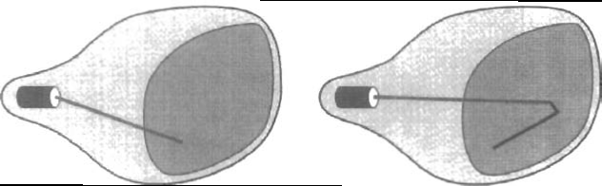
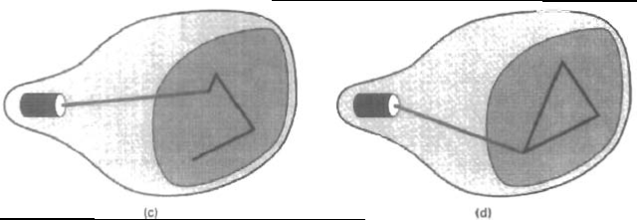
A random-scan system draws the component lines of an object in any order specified.
cgvr.korea.ac.kr

Slide 30
Raster vs. Random-scan Displays
 | RASTER | RANDOM
DISPLAY MECHANISM | E-beam traces entire screen from upper left corner to bottom right | E-beam can highlight random positions on the screen
DRAWING UNIT | Pixel | Line
IMAGE STORAGE | Frame Buffer | Display File
IMAGE TYPES | Can display very complex images with greater accuracy | Wire Frame modeling
IMAGE QUALITY | May be Jagged due to digitization Diagonal Lines are produced with lower intensity | Smooth lines as e-beam directly follows the line path Diagonal Lines are produced with equal intensity
REFRESHING | Entire Screen has to be refreshed | Only selected portions are redrawn
REFRESH RATE | Maximum 80 Hz | Higher refresh rates.
ANIMATIONS | Supported | Not supporting
COLORS | Higher Color Depth | Lesser colors and shades
COLOR TECHNIQUE | Shadow Masking | Beam Penetration
Computer Graphics

Slide 31
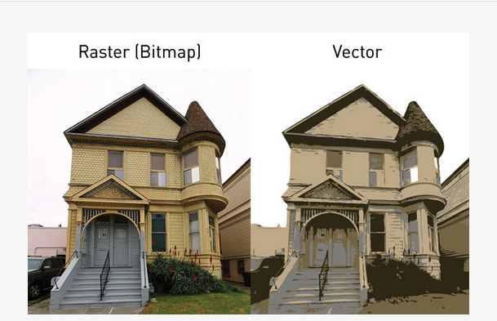
Madhulika (18010), Assistant Professor, LPU.

Slide 32
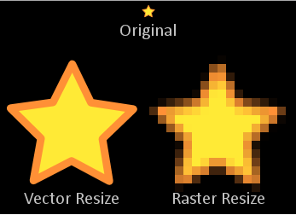
Madhulika (18010), Assistant Professor, LPU.

